Slide 1
SLEEP HEALTH & LIFESTYLE
Lifestyle Factors and Sleep Health
What lifestyle and health factors are linked to sleep quality and sleep disorders?
Dataset: Sleep Health and Lifestyle Dataset (Kaggle)
Presented by: Mubashra Munir
1

Slide 2
Problem & Dataset Overview
Research Question
374
13
3
“What lifestyle and health factors are linked to sleep quality and sleep disorders?”
People
Surveyed
Variables
Recorded
Sleep Disorder
Categories
Variable Types
Numeric: Age, Heart Rate, Daily Steps, Sleep Duration
Ordinal (1-10 scale): Quality of Sleep, Stress Level
Categorical: Gender, Occupation, BMI Category, Sleep Disorder
Why this matters
Sleep problems are widespread and closely tied to everyday habits. Understanding which lifestyle factors matter most can help identify people at risk and guide simple, practical interventions.
2

Slide 3
Data Cleaning
1
2
3
Missing Sleep Disorder values
Inconsistent BMI labels
Combined Blood Pressure field
219 of 374 rows were blank. This meant “no disorder,” not truly unknown, filled with “None”.
“Normal” and “Normal Weight” described the same category, merged into one label.
Stored as text like “126/83”, split into numeric Systolic and Diastolic columns.
Duplicate rows checked: none found
3

Slide 4
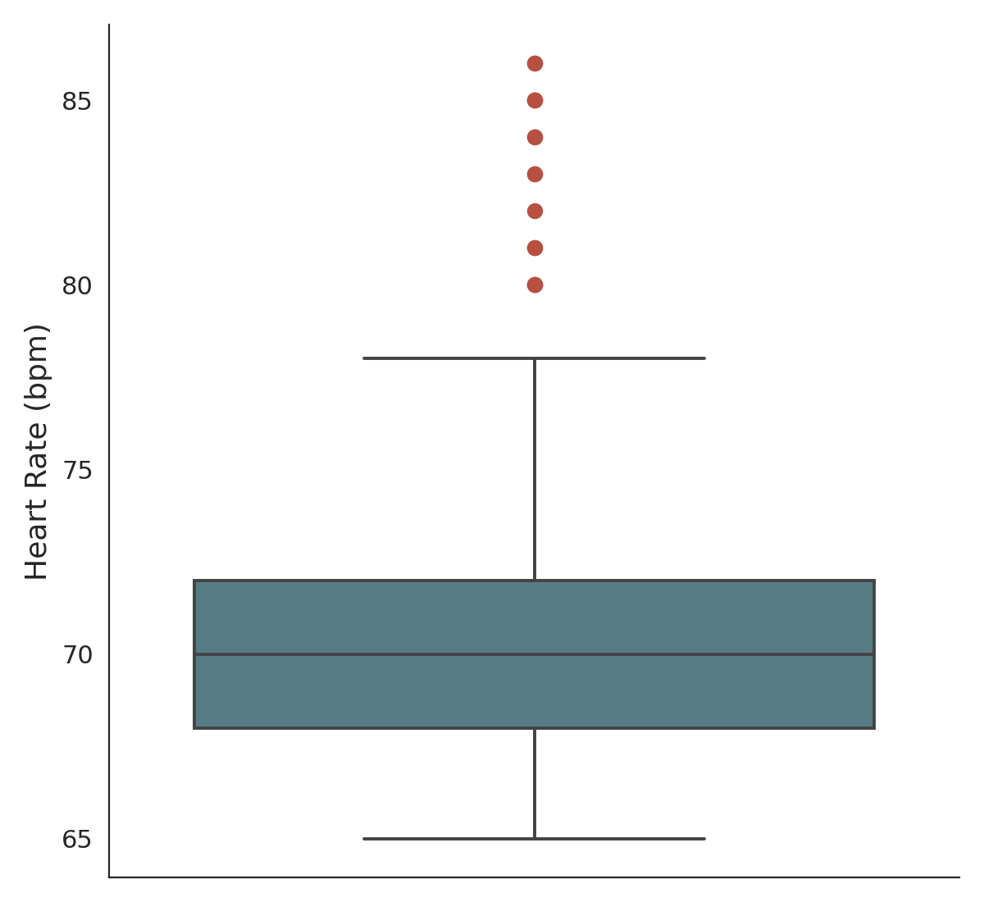
Data Cleaning: Outlier Check
Only Heart Rate showed outliers
All other numeric columns (Age, Sleep Duration, Stress Level, Daily Steps, Systolic, Diastolic) showed no outliers.
A few Heart Rate values sit around 80-86 bpm, above the main cluster.
86 bpm is still a realistic resting heart rate, not an error.
Decision: Keeping these values. They likely reflect real differences in fitness or stress, which is useful signal, not just noise.
4
Notes:
Beats per minute

Slide 5
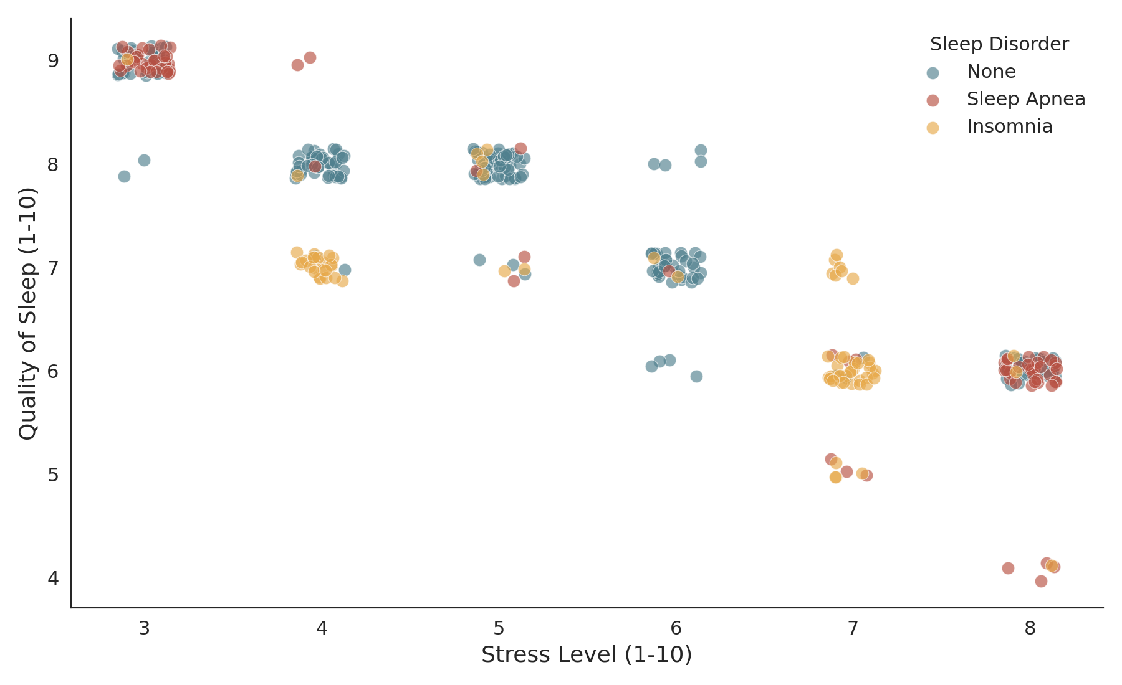
Stress Level vs Quality of Sleep
INSIGHT
Higher stress, worse sleep
As stress level rises, quality of sleep drops sharply. People with Sleep Apnea or Insomnia cluster in the high stress, low quality region, stress appears closely tied to disordered sleep, not just poor sleep quality alone.
5
Notes:
# Does stress affect sleep quality?
This is a scatterplot showing the relationship between Stress Level (x-axis, 1–10) and Quality of Sleep (y-axis, 1–10), with each point colored by whether that person has a Sleep Disorder (None, Sleep Apnea, or Insomnia). There's a clear downward trend — as stress increases, sleep quality decreases. Notably, the color pattern isn't random: at low stress (3–5), most points are blue ("None"), while at high stress (7–8), the points shift heavily to red and orange (Sleep Apnea and Insomnia). This suggests stress isn't just associated with feeling like you slept worse, but is also linked to actually having a diagnosed sleep disorder.
Sleep Apnea actually is: it's a physical breathing disruption during sleep, which someone can have without consciously feeling stressed or rating their sleep as poor — it's often diagnosed by a partner noticing snoring/breathing pauses, not by how rested the person feels
Insomnia is a sleep disorder where a person has trouble falling asleep, staying asleep, or getting good-quality sleep — even when they have the chance to sleep. People with insomnia often:
Take a long time to fall asleep
Wake up frequently during the night
Wake up too early and can't get back to sleep
Feel tired, irritable, or unfocused during the day, despite spending time in bed

Slide 6
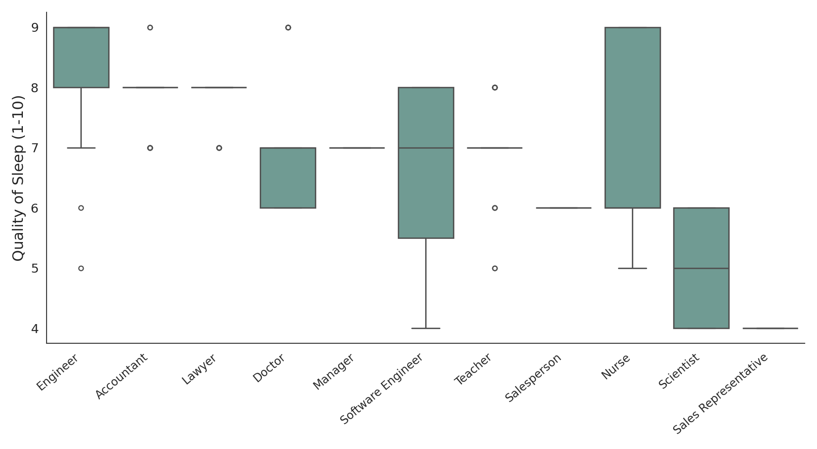
Quality of Sleep by Occupation
INSIGHT
Occupation matters
Engineers have the highest median sleep quality (9.0, n=63). Nurses' box looks tall, but their median is only 6.0, their scores are just highly spread out, from 5 to 9. Scientist and Sales Representative look lowest, but with only 4 and 2 people each, that pattern isn't reliable.
6
Notes:
#How does sleep quality vary by occupation?
Each box represents the spread of Quality of Sleep scores (1–10) for people in that occupation. The line inside each box is the median — the actual "typical" value — while the box edges show the middle 50% of scores, and the dots above/below are outliers.
Reading it correctly, occupation by occupation:
Engineer has the highest median (9.0) with a fairly tight box — most engineers cluster near the top
Accountant and Lawyer both sit at a median of 8.0
Nurse looks like it has a high median because the box is tall (spanning 6 to 9), but the median line itself is actually near the bottom of that box, around 6 — so "Nurses sleep best" is a visual illusion caused by how spread out their scores are, not their typical value
Doctor, Manager, Software Engineer, Teacher cluster in the middle, around 7
Salesperson sits at 6
Scientist and Sales Representative appear lowest, but only have 4 and 2 people in the entire dataset — far too few to trust as a real pattern

Slide 7
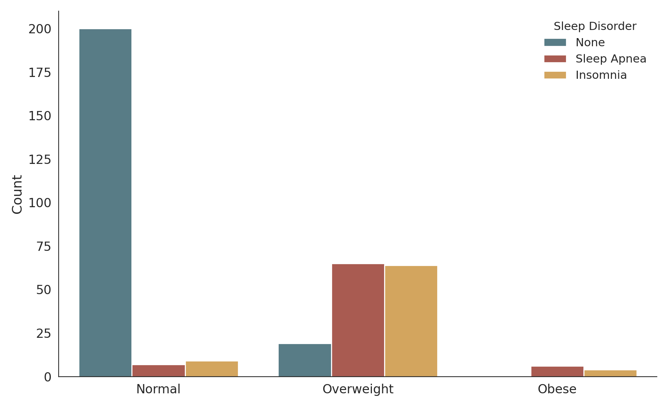
Sleep Disorder Count by BMI Category
INSIGHT
BMI is the strongest link
People with Normal BMI overwhelmingly report no sleep disorder. Overweight individuals show a dramatic jump in both Sleep Apnea and Insomnia, despite being a smaller group. Obese individuals show disorders exclusively.
7
Notes:
# Which BMI categories are linked to sleep disorder? Body Mass Index
For each BMI category (Normal, Overweight, Obese), the bars show how many people fall into each Sleep Disorder group: None (blue), Sleep Apnea (red), or Insomnia (gold).
Reading it with the actual numbers:
Normal BMI (216 people): Only 7.4% have a sleep disorder — 200 report None, just 7 have Sleep Apnea, 9 have Insomnia. This is the healthiest-looking group by far.
Overweight (148 people): A dramatic shift — 87.2% have a sleep disorder (65 Sleep Apnea, 64 Insomnia), against only 19 with none. Despite Overweight having far fewer people than Normal, its disorder counts (65, 64) are nearly as high as Normal's entire "None" count.
Obese (10 people): 100% have a sleep disorder (6 Sleep Apnea, 4 Insomnia) — no one reports "None." This is a striking pattern, but worth noting out loud: the sample is tiny (only 10 people), so while the direction is consistent with Overweight, the "100%" figure specifically shouldn't be oversold as a precise, generalizable number.
Genuinely
large, consistent jump — BMI category, more than stress or occupation, cleanly separates people with disorders from those without in this dataset. That's a legitimate, well-supported insight to lead with in your presentation.

Slide 8
Key Insights
01
Stress drives sleep quality down
Higher self reported stress consistently predicts lower sleep quality and a higher chance of a diagnosed sleep disorder.
02
Weight is the strongest single factor
Overweight and Obese individuals face far higher rates of Sleep Apnea and Insomnia than those with a Normal BMI.
03
Occupation reflects lifestyle pressure
Jobs with high median sleep quality (Nurses, Engineers) contrast sharply with lower scoring roles (Scientists, Sales), likely a proxy for workload and stress.
8

Slide 9
Tools & Process
Built entirely in Python, using Pandas for data cleaning and Seaborn / Matplotlib for visualization.
1
2
3
4
Load
Clean
Visualize
Interpret
Read the CSV with Pandas
Fix labels, split fields, handle nulls
Build charts with Seaborn
Connect findings to the question
Libraries used: pandas • numpy • seaborn • matplotlib
9

Slide 10
Conclusion
Sleep quality in this dataset is shaped most strongly by stress level and body weight, with occupation acting as a real world proxy for both. Maintaining stress and healthy weight stand out as the clearest, most actionable levers for better sleep.
Thank you — questions welcome
10
Notes:
"with occupation acting as a real-world proxy for both"
→ This means: occupation itself probably isn't the direct cause of poor sleep — it's standing in for other things, like how stressful or demanding that job tends to be. A "Scientist" job title doesn't cause bad sleep; the workload, pressure, or irregular hours that often come with that job might.
Another conclusion could be : Sleep quality in this dataset is shaped most clearly by stress level and body weight. Higher stress consistently tracks with Insomnia and lower self-rated sleep quality, while Overweight and Obese individuals show a dramatic jump in sleep disorder rates compared to Normal BMI (from roughly 7% up to 87%+). Occupation shows some variation too, but the pattern is inconsistent — it isn't a clean stand-in for stress or weight. Managing stress and maintaining a healthy weight stand out as the clearest, most actionable levers for better sleep.

